Slide 1


PARADISE
RESORTS
Integrated Management System & Data Analytics
Maham Zafar(2025-CS-182)
Areeba Aleem(2025-CS-183)
Ahsan Mustafa(2025-CS-197)
Muhammad Furqan(2025-CS-187)
Laiba Naeem(2025-CS-215)

Slide 2
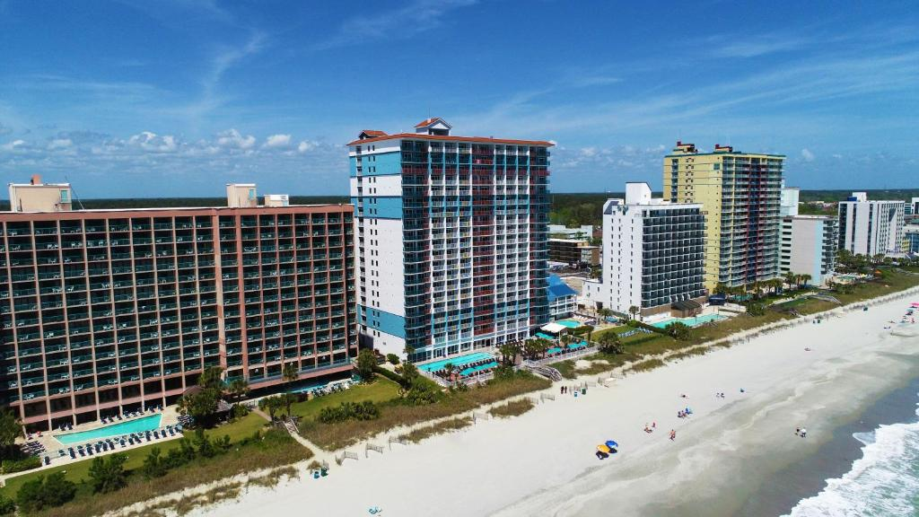

Objectives
To design and develop a luxury resort website that showcases premium services, including our dining, healthcare facilities, and exclusive fashion outlets.
To use Excel for managing resort operations, specifically by using formulas (like SUM, AVERAGE, and IF) to track service pricing, booking costs, and financial health.
To create a summary dashboard featuring charts that translate raw resort data into clear visual insights for better decision-making.

Slide 3
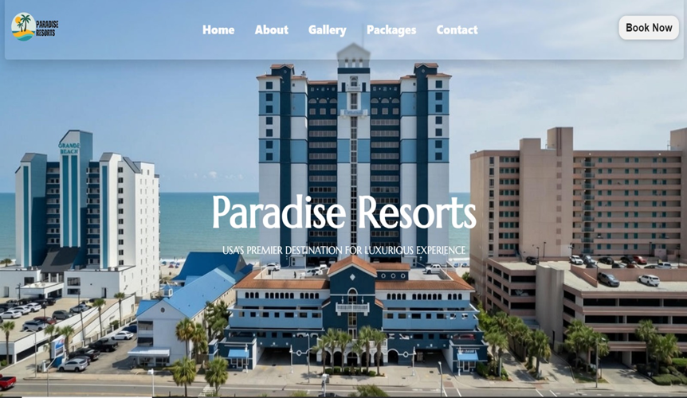
A professional landing page for featuring easy navigation to our About, Gallery, and Contact sections.
Direct access to our key offerings including Gourmet Dining, Healthcare support, and Luxury Fashion outlets.
Features a “Book Now” call-to-action that links guest inquiries to our backend management system.
Website Interface & Services

Slide 4
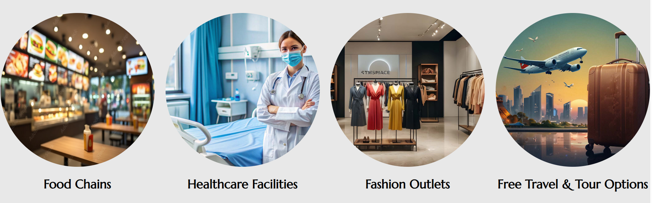
01
Gourmet Dining: Online menu showcasing 24/7 world-class culinary options.
02
Healthcare & Wellness: Professional support facilities integrated into the resort experience.
Our Facilities
03
Retail & Leisure: Exclusive on-site fashion and curated tour packages.
04
Service Tracking: Each service category is linked to our Excel database for inventory and pricing management.

Slide 5
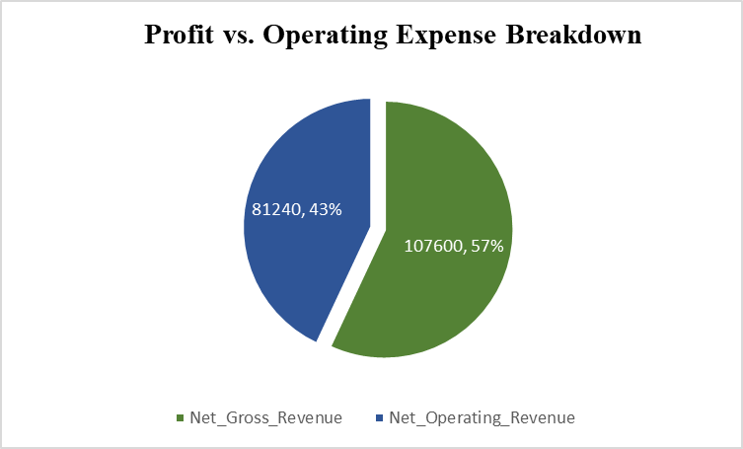
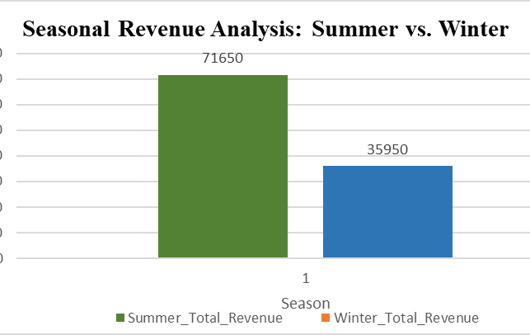
Data Analytics & Financial Overview
01
Revenue Analysis: Visual breakdown of income generated by the four service categories shown on Slide 4.
02
Data Consistency: Real-time tracking of booking costs and inventory levels.
03
Decision Support: Using data visualization to monitor the financial health of Paradise Resorts.

Slide 6
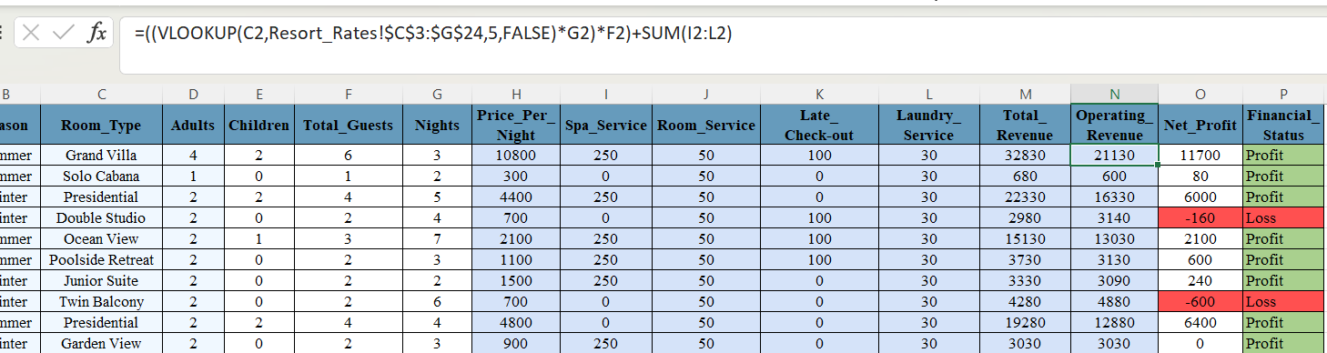
Backend Logic & Excel Integration
01
02
03
Automated Calculations: Utilizing Excel formulas to automate pricing updates and expense tracking.
Formula Logic: Implementation of logical functions (e.g., IF statements) to determine seasonal discounts or inventory alerts.
Database Integrity: Ensuring all tabular data is structured to support real-time resort management.

Slide 7
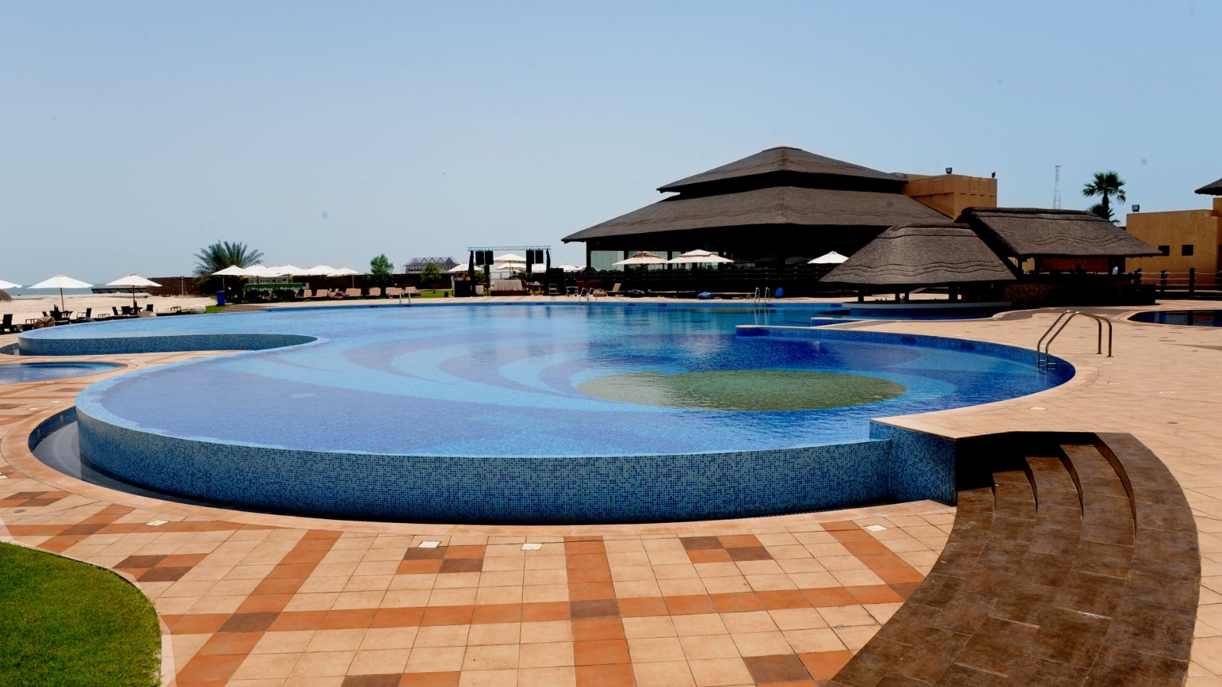
Creative Design & Branding Strategy
01
Tool Selection: Developed the presentation using PowerPoint to achieve a high-end, professional aesthetic.
02
Color Psychology: Used a Blue, Deep Teal and Gold palette to evoke feelings of relaxation and luxury, fitting for a premium resort.
03
Visual Consistency: Applied the Slide Master principle to ensure uniform fonts, logos, and layouts across all slides for a cohesive brand identity.
04
Typography: Selected clean, modern Sans-Serif fonts ( Marcellus & Lato ) to ensure readability during the future video animation.

Slide 8
Reflection & Problem Solving
Website Development (Front-End)
Reflection: Creating a responsive UI for Paradise Resorts required balancing luxury aesthetics with clear navigation.
Challenge: Ensuring the screenshots captured the full "user experience" for the presentation.
Excel Analytics (Back-End)
Reflection: The core of the project was making the data functional rather than just visual.
Challenge: Writing complex VLOOKUP and SUM formulas to ensure that guest totals were 100% accurate.
Word Documentation & Integration
Reflection: Using Word to document the project helped structure the final report and explain the technical logic clearly.
Challenge: Keeping the data consistent across the website screenshots, the Excel tables, and the Word report.

Slide 9
Final Summary & Project Access
The Summary :
Project Accomplishment: Successfully built an integrated Resort Management System bridging creative design and technical data.
Technical Synergy: Demonstrated proficiency in HTML/CSS (Web), Advanced Excel (Data), Word, and PowerPoint (Branding).
Professional Workflow: Utilized GitHub for version control and LinkedIn for professional networking.
🌐 Live Website Demo:
https://ahsanmus.github.io/Group-3_Holiday-Resort/
📁 Source Code (GitHub): https://github.com/ahsanmus/Group-3_Holiday-Resort/tree/main
📧 Contact: +92 317 7050444

Slide 10
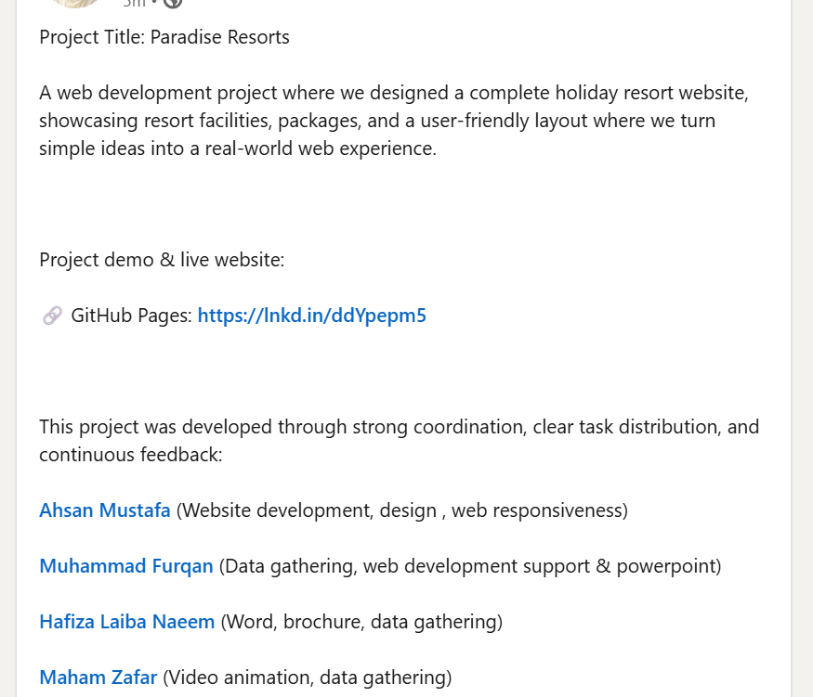
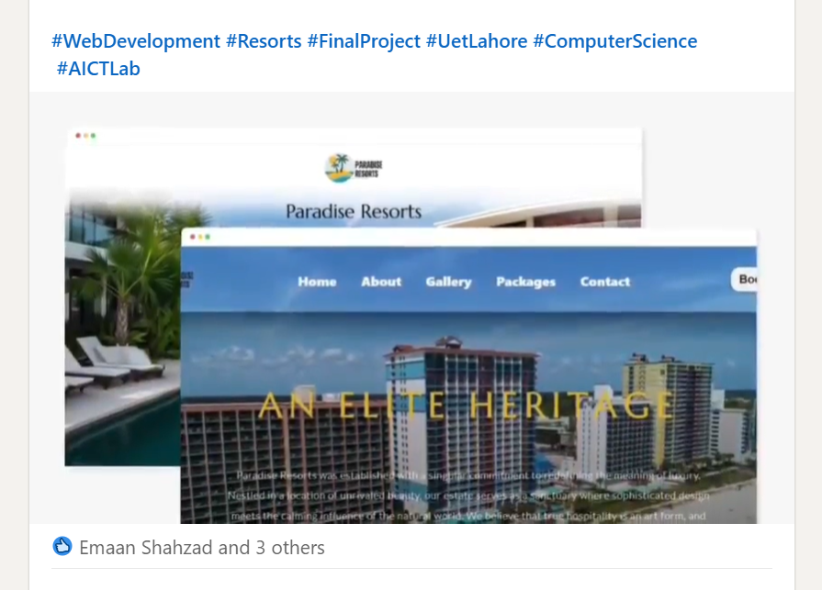
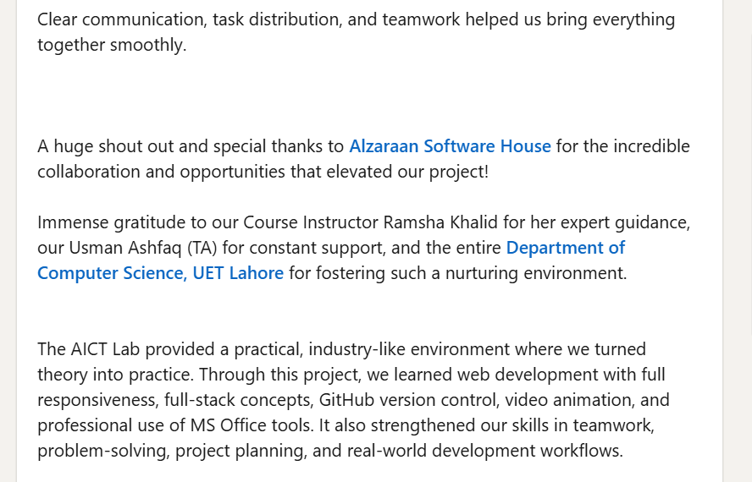
LinkedIn Post

